Slide 1
EGO – Waling on Slopes
Modelling and control of an inverse pendulum over a unicycle on slopes

Slide 2
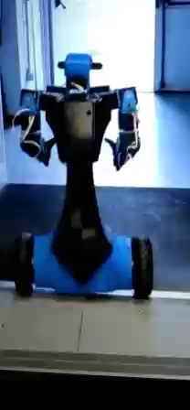
Goal
The goal of the project is to let Alter-Ego to walk on a slope.
In order to achive this we modelled from scratch and controlled the system, that is an inverse pendulum over a unicycle, taking into account the slope angle.
The control technique here proposed is model-based, therefore the estimation of the slope angle is required.
For the estimation of the slope angle and the other state variables two types of estimators are proposed and compared.

Slide 3
Simulink System
Controller
Model
Sensors
Estimator

Slide 4
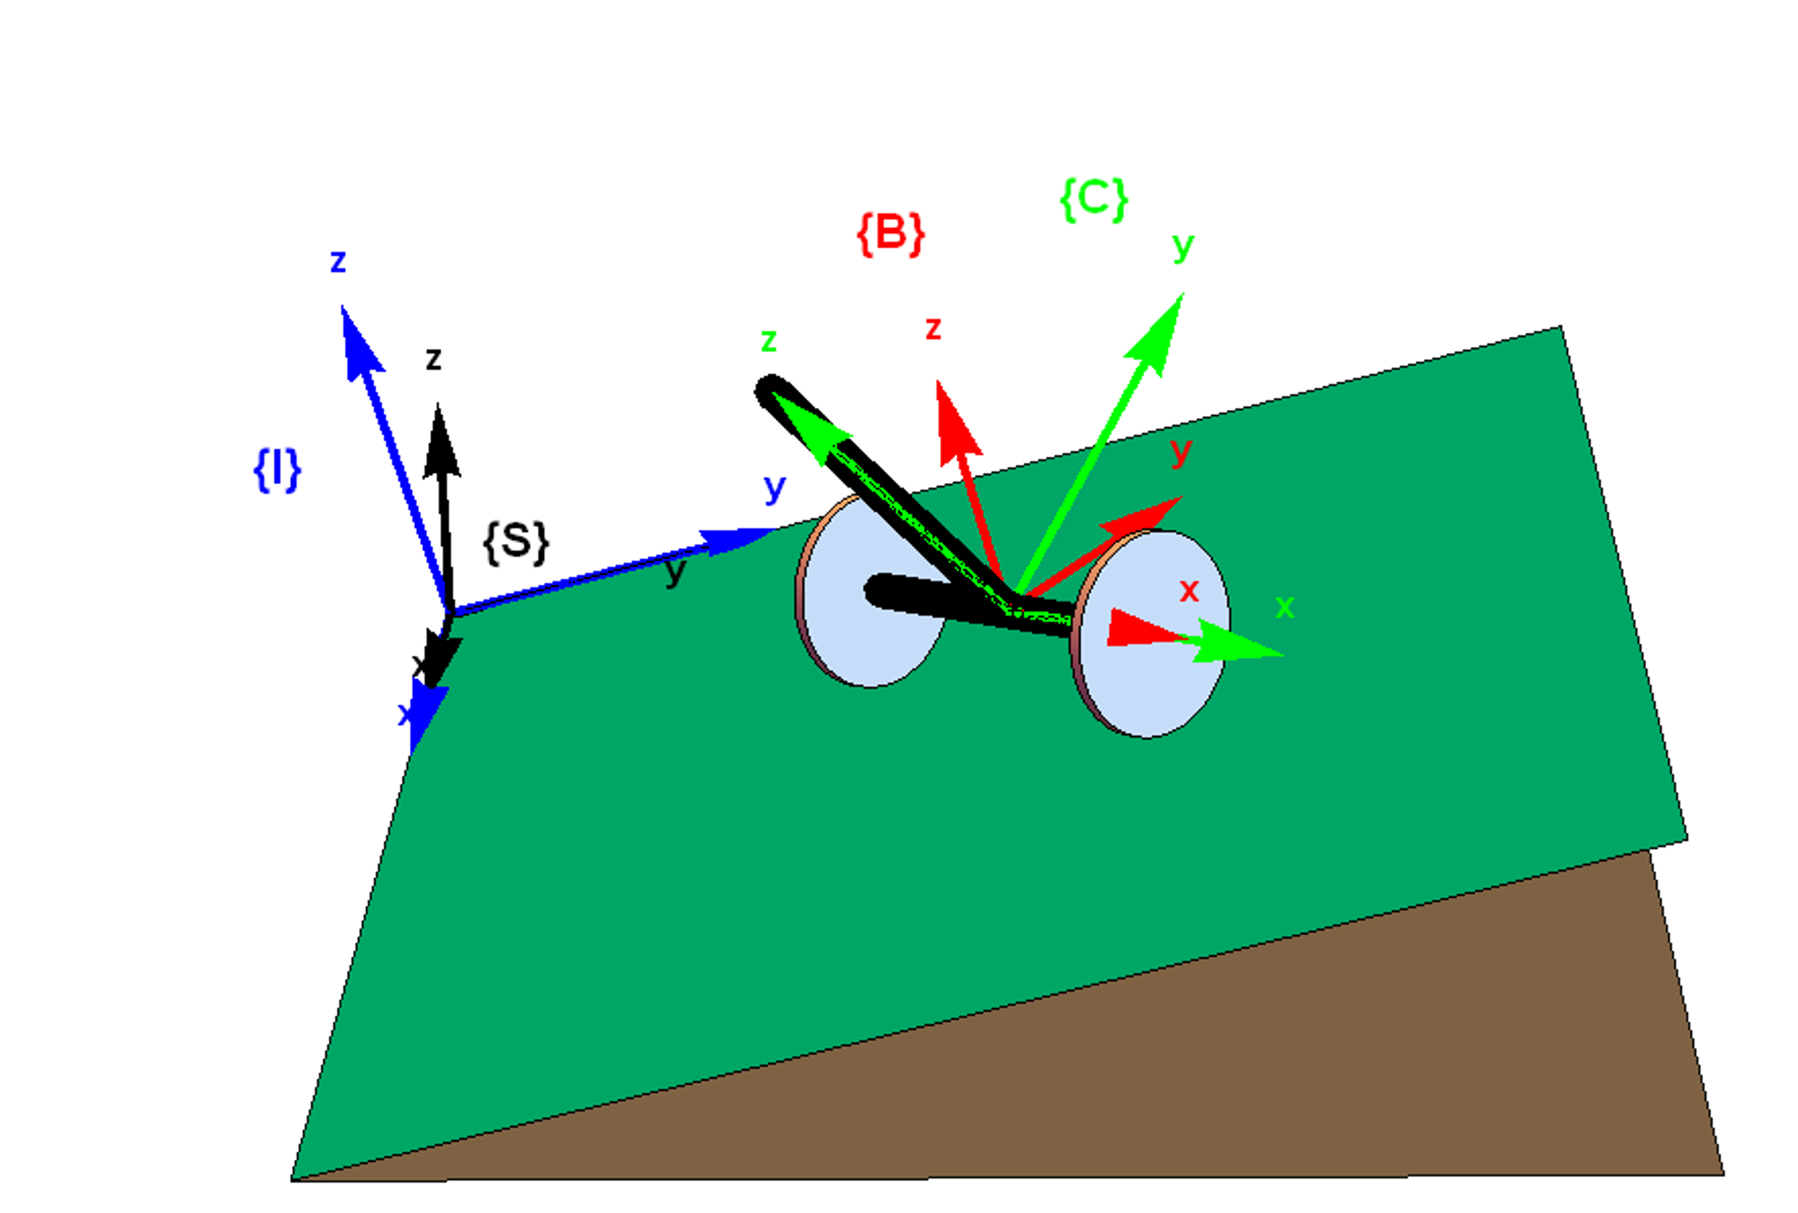
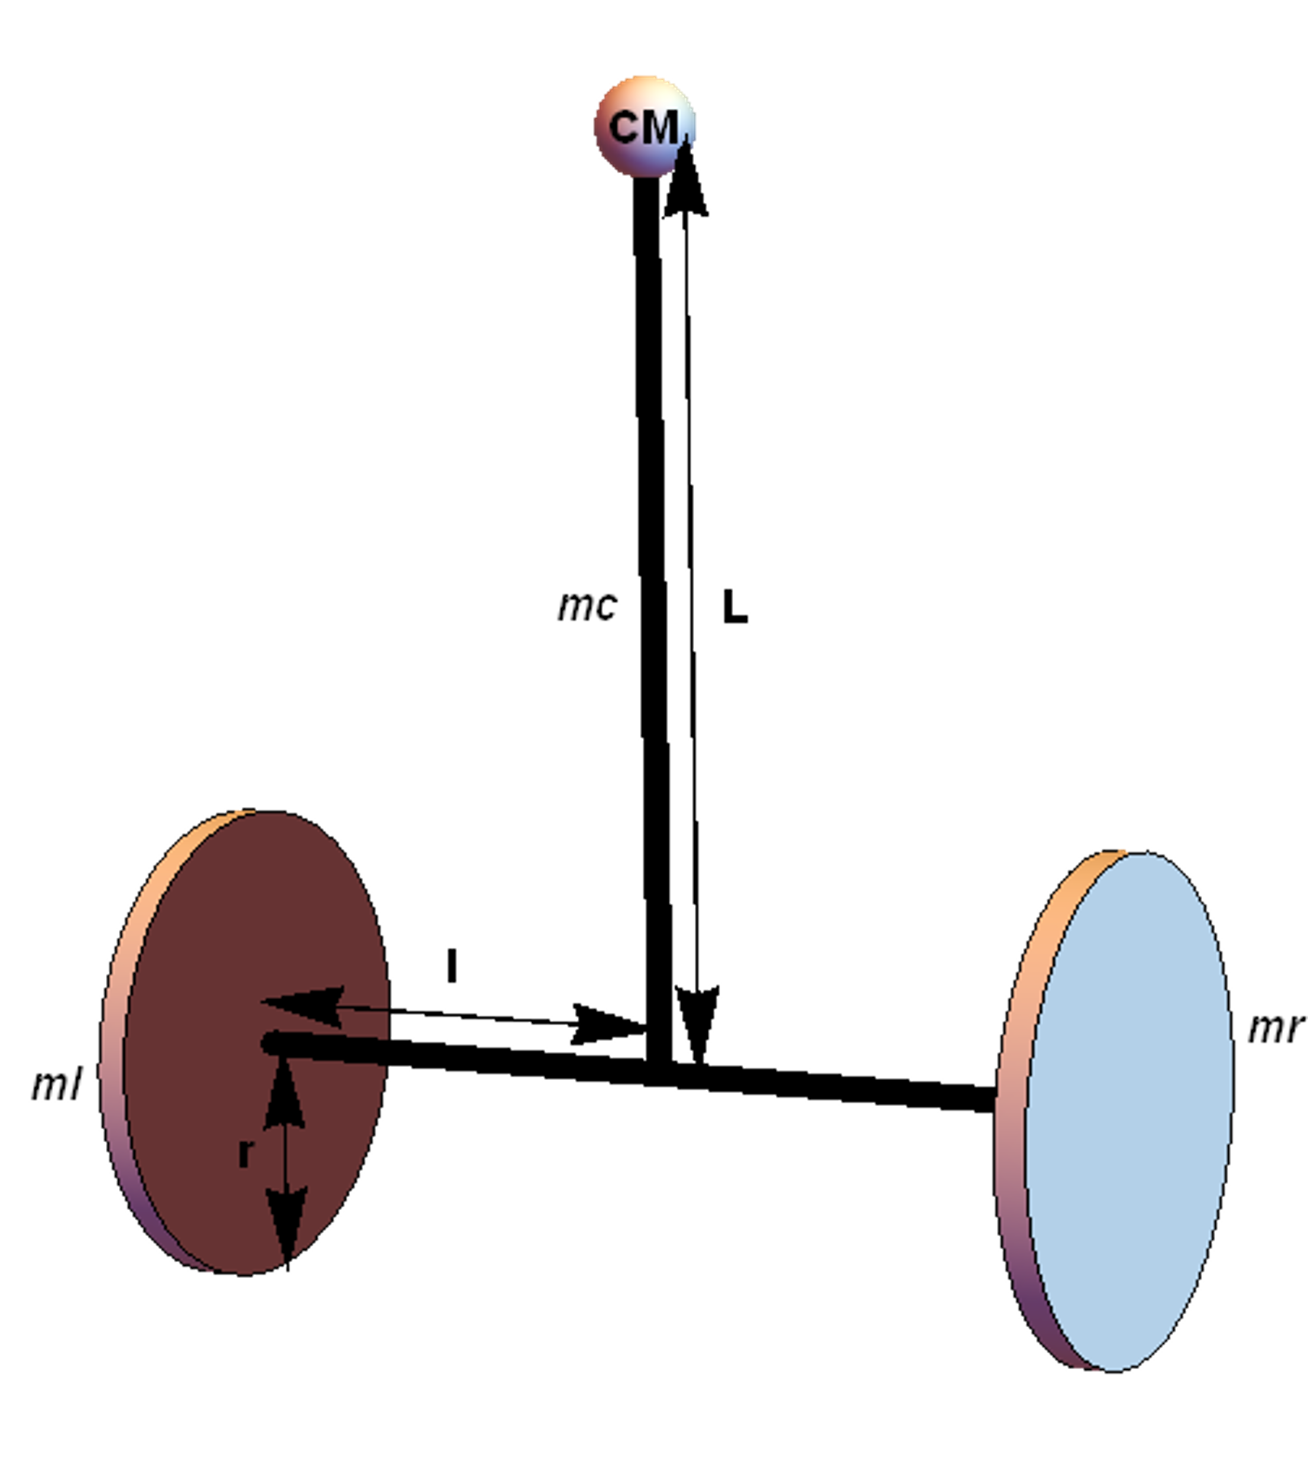
Referece Systems and Physical Parameters
Parameters taken from G. Lentini et al., "Alter-Ego: A Mobile Robot With a Functionally Anthropomorphic Upper Body Designed for Physical Interaction,"
in IEEE Robotics & Automation Magazine, vol. 26, no. 4, pp. 94-107, Dec. 2019, doi: 10.1109/MRA.2019.2943846.

Slide 5
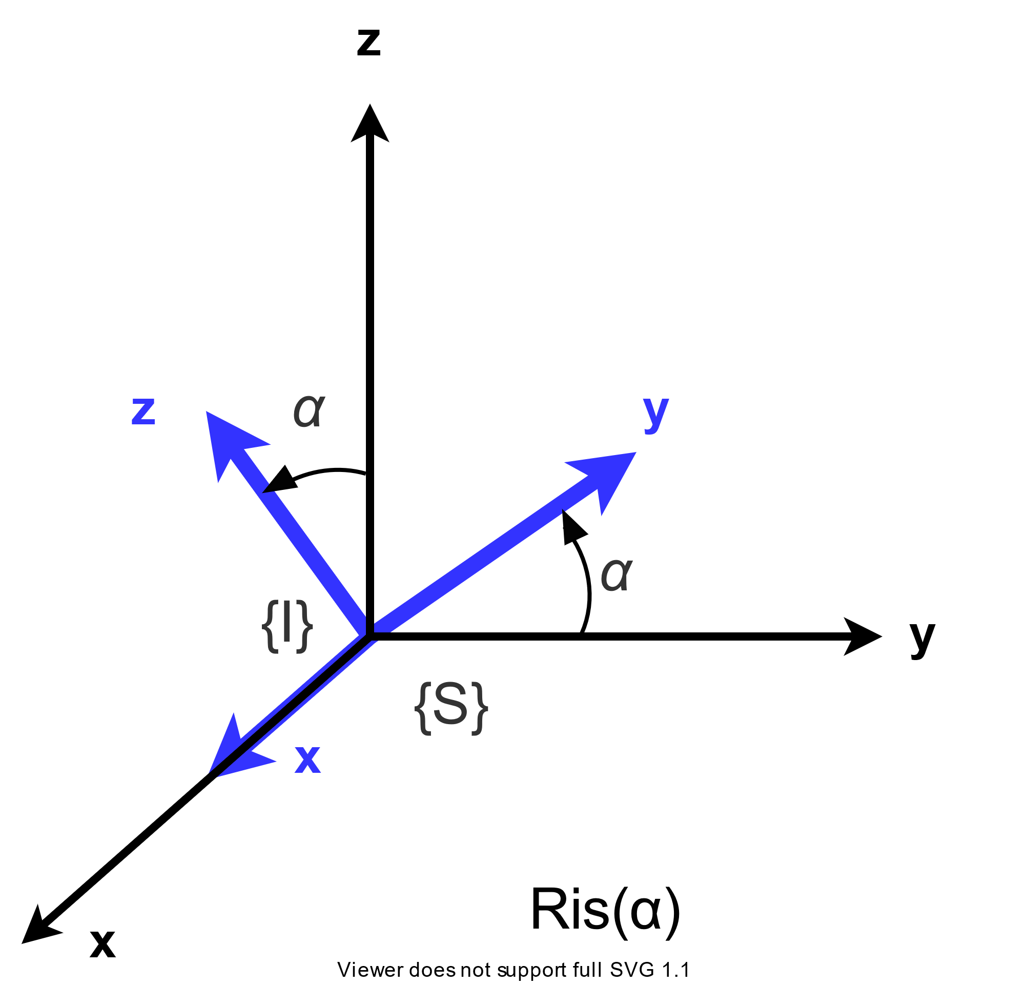
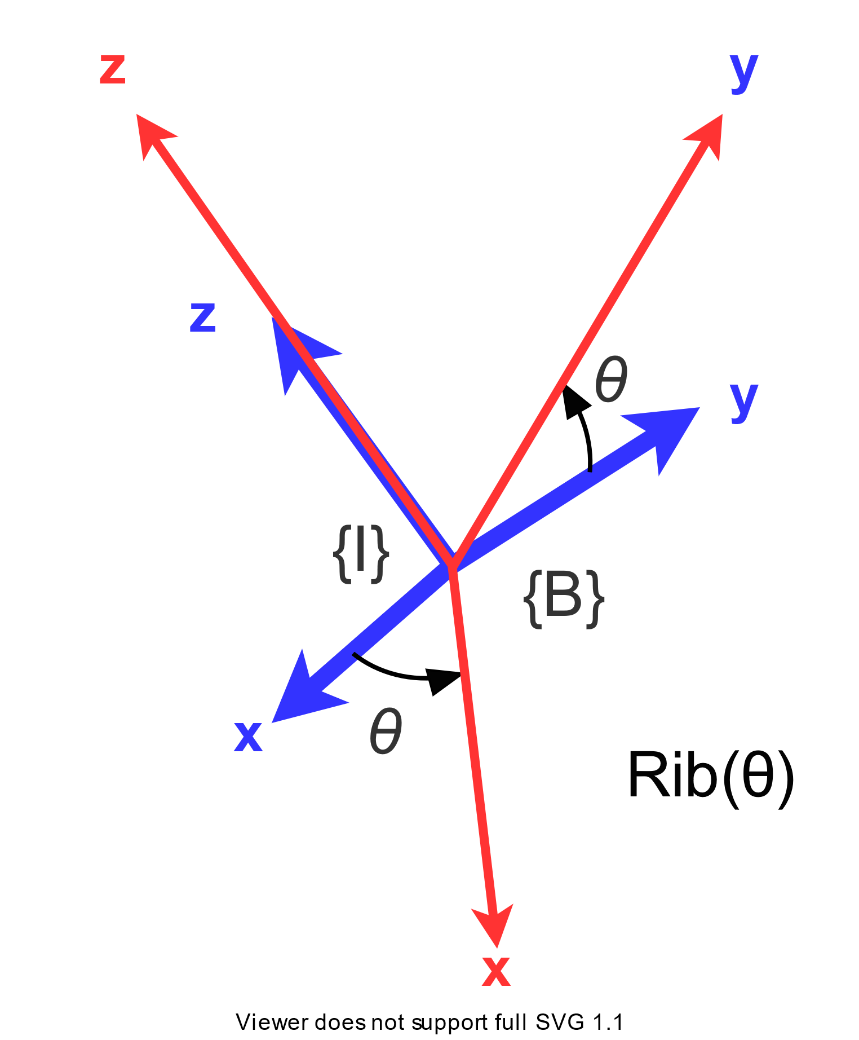
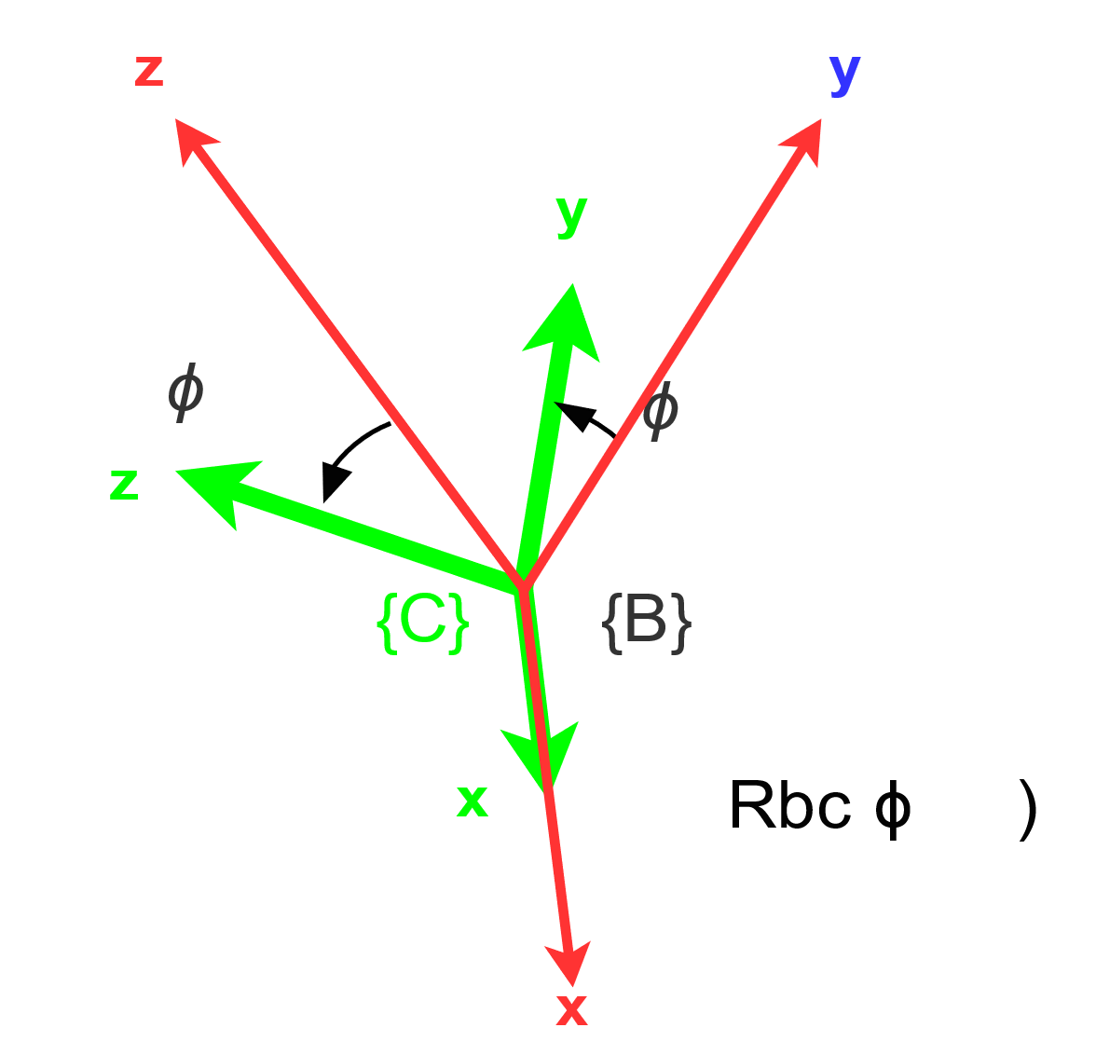
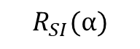
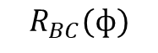
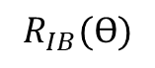
Denavit - Hartenberg
y
y
 | β_{x} | β_{z} | T
{S} → {I} | α | 0 | 0
{I} → {B} | 0 | Ѳ* | (x*, y*, r)
{B} → {C} | ф* | 0 | 0
{I}
{I}
{B}
{B}
$$R_{SI}(α)$$
$$R_{IB}(Ѳ)$$
$$R_{BC}(ф)$$
Generalized coordinates: $q=[\text{x}\text{, }\text{y}\text{,} \text{Ѳ}\text{,} \text{ф}\text{,} \text{γ}\text{r}\text{ , }\text{γ}\text{l}]$ where γ_{r} and γ_{l} are the wheels’ angular coordinates

Slide 6
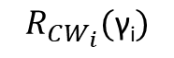
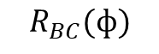
Denavit - Hartenberg
 | β_{x} | β_{z} | T
{S} → {I} | α | 0 | 0
{I} → {B} | 0 | Ѳ* | (x*, y*, r)
{B} → {C} | ф* | 0 | 0
{C} → {W_{i}} | γ_{i}* | 0 | 0
y
y
y
{W_{i}}
γ_{i}
z
{C}
{B}
γ_{i}
$$R_{CW_{i}}(\text{γ}\text{i})$$
z
$$R_{BC}(ф)$$
x
x

Slide 7
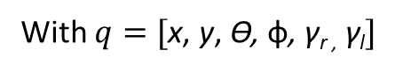
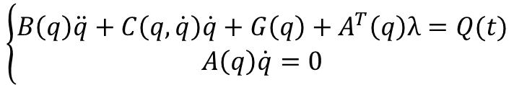
Dynamics
Constrained dynamics equations
$$\left\{\begin{aligned}B\left(q\right)\ddot{q}+C\left(q,\dot{q}\right)\dot{q}+G\left(q\right)+A^{T}\left(q\right)λ=Q(t) \\ A\left(q\right)\dot{q}=0\end{aligned}\right.$$
With $q=[\text{x}\text{, }\text{y}\text{,} \text{Ѳ}\text{,} \text{ф}\text{,} \text{γ}\text{r}\text{ ,} \text{γ}\text{l}]$

Slide 8
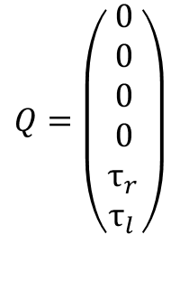
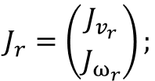
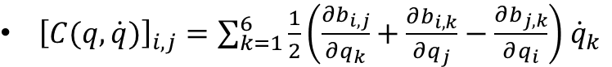
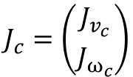
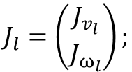
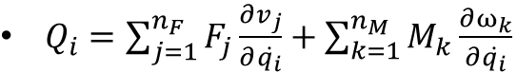
Dynamics Equations Matrices
$$J_{r}=\left({J_{v_{r}} \atop J_{ω_{r}}}\right);$$
$$J_{l}=\left({J_{v_{l}} \atop J_{ω_{l}}}\right);$$
$$J_{c}=\left({J_{v_{c}} \atop J_{ω_{c}}}\right)$$
$B=(m_{r}J_{v_{r}}^{T}J_{v_{r}}+J_{ω_{r}}^{T}I_{r}J_{ω_{r}})+$ $(m_{l}J_{v_{l}}^{T}J_{v_{l}}+J_{v_{l}}^{T}I_{l}J_{v_{l}})+$ $\left(m_{c}J_{v_{c}}^{T}J_{v_{c}}+J_{ω_{c}}^{T}I_{c}J_{ω_{c}} \right);$
${\left[C(q,\dot{q})\right]}_{i,j}=\sum_{k=1}^{6}{\frac{1}{2}\left(\frac{∂b_{i,j}}{∂q_{k}}+\frac{∂b_{i,k}}{∂q_{j}}−\frac{∂b_{j,k}}{∂q_{i}}\right){ \dot{q}}_{k}}$
$G_{i}=− m_{r}g J_{r}^{i}−$ $m_{l}g J_{l}^{i}−m_{c}g J_{c}^{i}$ where $J_{r,l,c}^{i}$ is the $i$-th column
$$Q=\left(\begin{matrix}0 \\ 0 \\ 0 \\ 0 \\ τ_{r_{ }} \\ τ_{l_{ }}\end{matrix}\right)$$
$Q_{i}=\sum_{j=1}^{n_{F}}{F_{j}\frac{∂v_{j}}{∂\dot{q_{i}}}+\sum_{k=1}^{n_{M}}{M_{k}\frac{∂ω_{k}}{∂\dot{q_{i}}}}}$

Slide 9
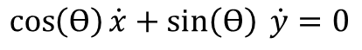
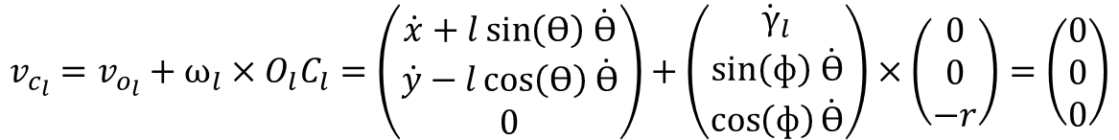
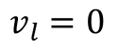
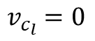
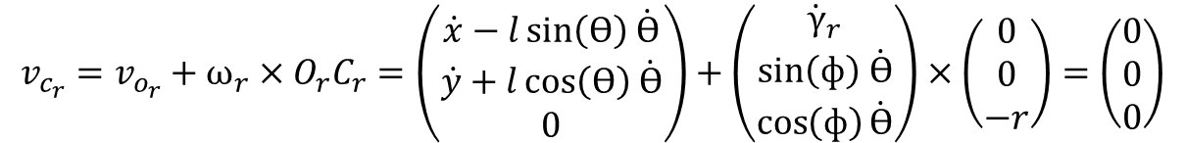
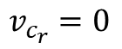
Constraints
Null lateral velocity
$$v_{l}=0$$
⇔
$$\cos\left(Ѳ\right)\dot{x}+\sin\left(Ѳ\right) \dot{y}=0$$
Right wheel pure rolling
$$v_{c_{r}}=v_{o_{r}}+ω_{r}×O_{r}C_{r}=\left(\begin{matrix}\dot{x}−l\sin\left(Ѳ\right) \dot{Ѳ} \\ \dot{y}+l\cos\left(Ѳ\right) \dot{Ѳ} \\ 0\end{matrix}\right)+\left(\begin{matrix}{\dot{γ}}_{r} \\ sin\left(ф\right) \dot{Ѳ} \\ \cos\left(ф\right)\dot{Ѳ}\end{matrix}\right)×\left(\begin{matrix}0 \\ 0 \\ −r\end{matrix}\right)=\left(\begin{matrix}0 \\ 0 \\ 0\end{matrix}\right)$$
$$v_{c_{r}}=0$$
⇔
Left wheel pure rolling
$$v_{c_{l}}=v_{o_{l}}+ω_{l}×O_{l}C_{l}=\left(\begin{matrix}\dot{x}+l\sin\left(Ѳ\right) \dot{Ѳ} \\ \dot{y}−l\cos\left(Ѳ\right) \dot{Ѳ} \\ 0\end{matrix}\right)+\left(\begin{matrix}{\dot{γ}}_{l} \\ sin\left(ф\right) \dot{Ѳ} \\ \cos\left(ф\right)\dot{Ѳ}\end{matrix}\right)×\left(\begin{matrix}0 \\ 0 \\ −r\end{matrix}\right)=\left(\begin{matrix}0 \\ 0 \\ 0\end{matrix}\right)$$
$$v_{c_{l}}=0$$
⇔

Slide 10

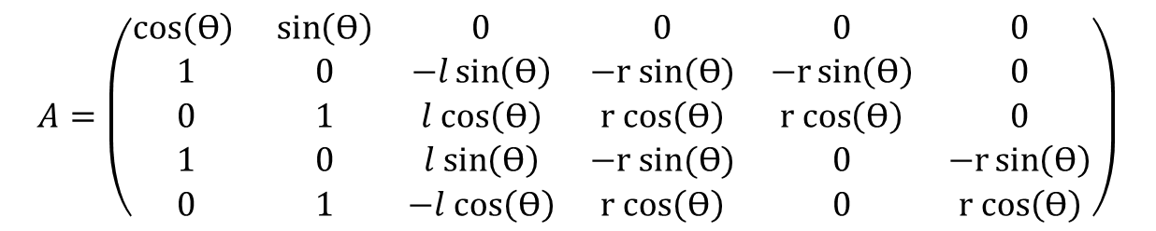
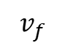
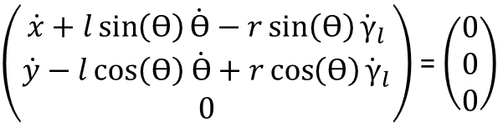
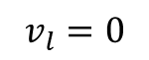
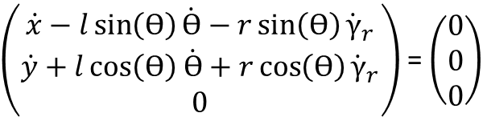
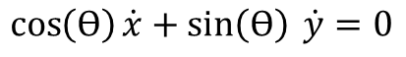
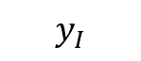
Pfaffian Matrix
Null lateral velocity
Right wheel pure rolling
Left wheel pure rolling
$$\cos\left(Ѳ\right)\dot{x}+\sin\left(Ѳ\right) \dot{y}=0$$
$\left(\begin{matrix}\dot{x}−l\sin\left(Ѳ\right)\dot{Ѳ}−r\sin\left(Ѳ\right){\dot{γ}}_{r} \\ \dot{y}+l\cos\left(Ѳ\right) \dot{Ѳ}+r\cos\left(Ѳ\right){\dot{γ}}_{r} \\ 0\end{matrix}\right)$ = $\left(\begin{matrix}0 \\ 0 \\ 0\end{matrix}\right)$
$\left(\begin{matrix}\dot{x}+l\sin\left(Ѳ\right)\dot{Ѳ}−r\sin\left(Ѳ\right){\dot{γ}}_{l} \\ \dot{y}−l\cos\left(Ѳ\right) \dot{Ѳ}+r\cos\left(Ѳ\right){\dot{γ}}_{l} \\ 0\end{matrix}\right)$ = $\left(\begin{matrix}0 \\ 0 \\ 0\end{matrix}\right)$
$$y_{I}$$
Resultant pfaffian matrix
$$v_{f}$$
Ѳ
$$v_{l}=0$$
$$A=\left(\begin{matrix}cos\left(Ѳ\right) & \sin\left(Ѳ\right) & 0 & 0 & 0 & 0 \\ 1 & 0 & −l\sin\left(Ѳ\right) & −r sin(Ѳ) & −r\sin\left(Ѳ\right) & 0 \\ 0 & 1 & l cos\left(Ѳ\right) & r cos\left(Ѳ\right) & r cos\left(Ѳ\right) & 0 \\ 1 & 0 & l sin\left(Ѳ\right) & −r sin(Ѳ) & 0 & −r\sin\left(Ѳ\right) \\ 0 & 1 & −l cos\left(Ѳ\right) & r cos\left(Ѳ\right) & 0 & r cos\left(Ѳ\right)\end{matrix}\right)$$
Ѳ
$$x_{I}$$

Slide 11
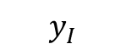
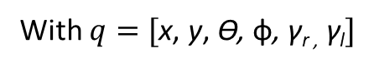

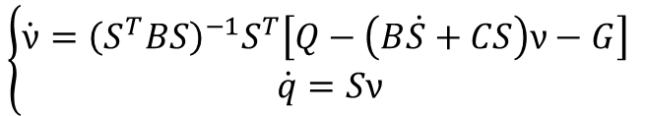
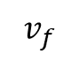
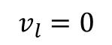
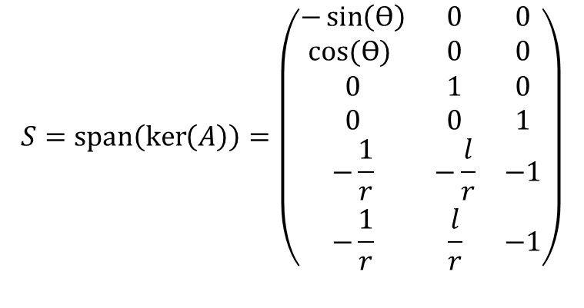
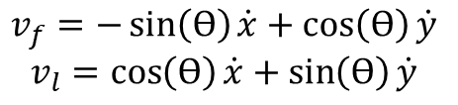
Quasi-Velocities Solutions
$$\left\{\begin{aligned}\dot{ν}={\left(S^{T}BS\right)}^{−1}S^{T}\left[Q−\left(B\dot{S}+CS\right)ν−G\right] \\ \dot{q}=Sν\end{aligned}\right.$$
With $q=[\text{x}\text{, }\text{y}\text{,} \text{Ѳ}\text{,} \text{ф}\text{,} \text{γ}\text{r}\text{ ,} \text{γ}\text{l}]$
$$v_{f}=−\sin\left(Ѳ\right)\dot{x}+\cos\left(Ѳ\right)\dot{y}$$
$$v_{l}=\cos\left(Ѳ\right)\dot{x}+\sin\left(Ѳ\right)\dot{y}$$
$$S=span\left(\ker\left(A\right)\right)=\left(\begin{matrix}−\sin\left(Ѳ\right) & 0 & 0 \\ cos⁡(Ѳ) & 0 & 0 \\ 0 & 1 & 0 \\ 0 & 0 & 1 \\ −\frac{1}{r} & −\frac{l}{r} & −1 \\ −\frac{1}{r} & \frac{l}{r} & −1\end{matrix}\right)$$
$$y_{I}$$
$$v_{f}$$
Ѳ
$$v_{l}=0$$
Ѳ
$$x_{I}$$

Slide 12
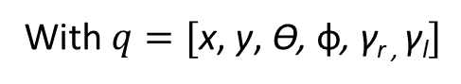
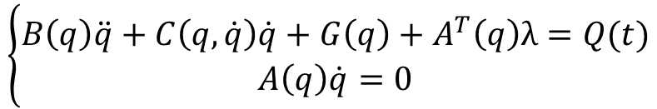
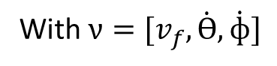
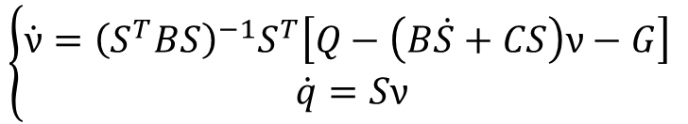
Final System
Constrained dynamics equations
$$\left\{\begin{aligned}B\left(q\right)\ddot{q}+C\left(q,\dot{q}\right)\dot{q}+G\left(q\right)+A^{T}\left(q\right)λ=Q(t) \\ A\left(q\right)\dot{q}=0\end{aligned}\right.$$
With $q=[\text{x}\text{, }\text{y}\text{,} \text{Ѳ}\text{,} \text{ф}\text{,} \text{γ}\text{r}\text{ , }\text{γ}\text{l}]$
Quasi velocities solution
$$\left\{\begin{aligned}\dot{ν}={\left(S^{T}BS\right)}^{−1}S^{T}\left[Q−\left(B\dot{S}+CS\right)ν−G\right] \\ \dot{q}=Sν\end{aligned}\right.$$
With $ν=[v_{f},\dot{Ѳ},\dot{ф}]$

Slide 13
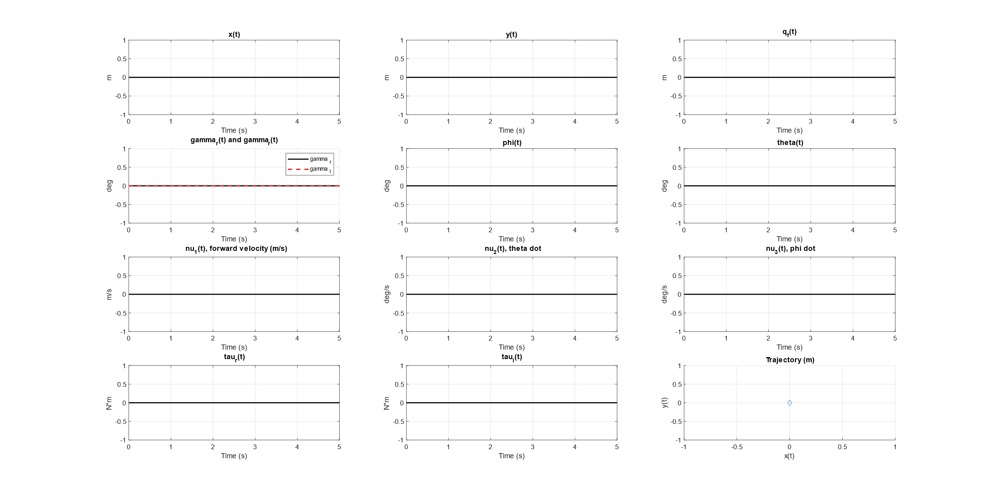
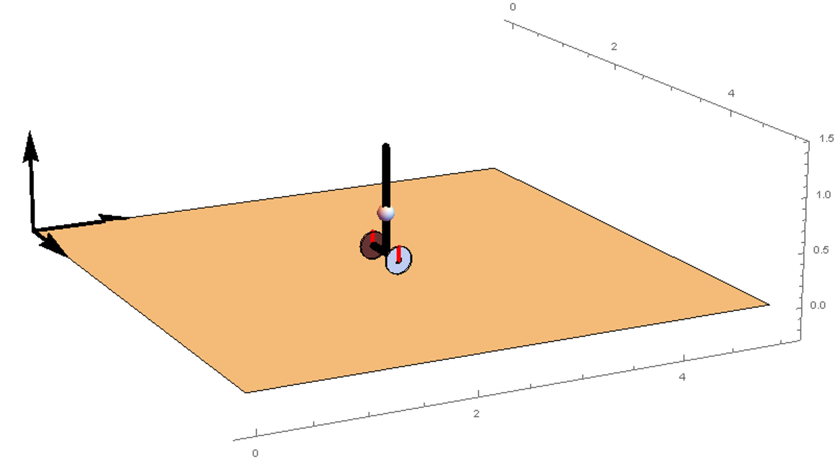
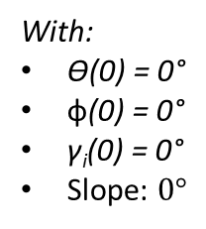
Non-Actuated Model
With:
$\text{Ѳ}\text{(0)}\text{ = 0°}$
$\text{ф}\text{(0)}\text{ = 0°}$
$\text{γ}\text{i}\text{(0) = 0°}$
Slope: $0°$

Slide 14


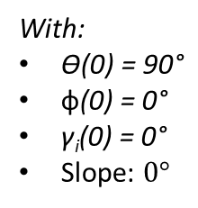
Non-Actuated Model
With:
$\text{Ѳ}\text{(0)}\text{ = 90°}$
$\text{ф}\text{(0)}\text{ = 0°}$
$\text{γ}\text{i}\text{(0) = 0°}$
Slope: $0°$

Slide 15
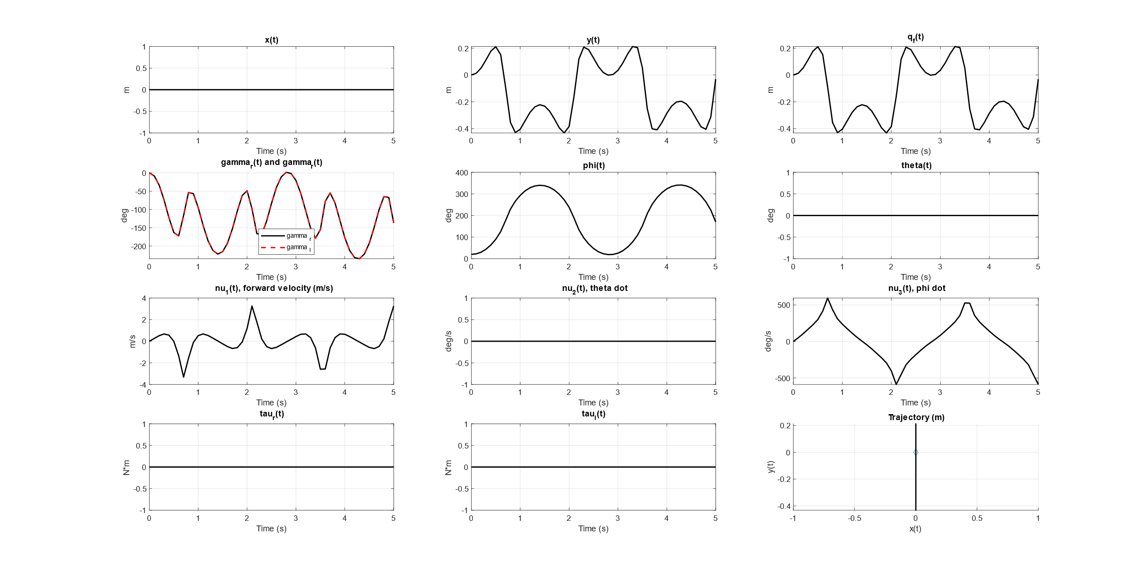
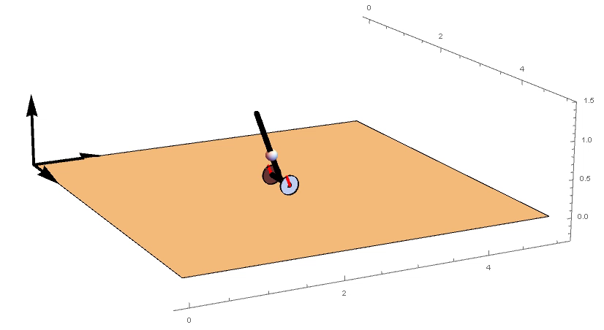
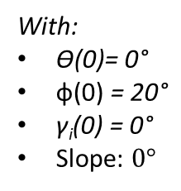
Non-Actuated Model
With:
$\text{Ѳ}\text{(0)= 0°}$
$\text{ф}\text{(0)}\text{ = 20°}$
$\text{γ}\text{i}\text{(0) = 0°}$
Slope: $0°$

Slide 16



Non-Actuated Model
With:
$\text{Ѳ}\text{(0) = 0°}$
$\text{ф}\text{(0)}\text{ = 0°}$
$\text{γ}\text{i}\text{(0) = 0°}$
Slope: $20°$

Slide 17



Equilibria
$$\left\{\begin{aligned}\dot{ν}={\left(S^{T}BS\right)}^{−1}S^{T}\left[Q−\left(B\dot{S}+CS\right)ν−G\right] \\ \dot{q}=Sν\end{aligned}\right.$$
Our state is $ξ=\left[x,y,θ,ф,γ_{r},γ_{l},v_{f},\dot{θ},\dot{ф}\right]$
We set $\dot{ξ}=0$ and ${\left[τ_{r},τ_{l}\right]}^{T}={[0, 0]}^{T}$ then
$\overline{ξ}=\left[x,y, \frac{(2n_{1}−1)π}{2},n_{2}π,γ_{r},γ_{l},0,0,0\right]$ with $n_{1}\text{,}n_{2}\text{∈} \text{ℕ}$
The results we obtained are similar to the ones obtained in: K. Peng, X. Ruan and G. Zuo, "Dynamic model and balancing control for two-wheeled self-balancing mobile robot on the slopes," Proceedings of the 10th World Congress on Intelligent Control and Automation, 2012, pp. 3681-3685, doi: 10.1109/WCICA.2012.6359086.

Slide 18



Model: Input-Output
Model
$$\text{τ}$$
$$q,ν$$
Input:
$\text{τ}={\left({\text{τ}}_{r},{\text{τ}}_{l}\right)}^{T}$, that are right and left torque
Output:
$q={\left(x,y,Ѳ,ф,γ_{r},γ_{l} \right)}^{T}$, that are: x and y coordinates, yaw, pitch, wheels angolar position
$ν={\left(v_{f},\dot{Ѳ},\dot{ф} \right)}^{T}$, that are: forward speed, yaw rate, pitch rate

Slide 19
Sensors Modelling
Ego – Walking on slopes

Slide 20


Simulink System
Controller
$$\text{τ}$$
Model
Sensors
$$q,ν$$
Estimator

Slide 21




IMU Implementation
$${\left[\tilde{\text{a}}\right]}_{C}=R_{CI}\left(\begin{aligned}\ddot{x} \\ \ddot{y} \\ 0\end{aligned}\right) −R_{CS}g+n_{a}$$
$${\left[\tilde{\text{ω}}\right]}_{C}=\left(\begin{aligned}\dot{ф} \\ 0 \\ 0\end{aligned}\right)+R_{CI}\left(\begin{aligned}0 \\ 0 \\ \dot{Ѳ}\end{aligned}\right)+n_{g}$$
$${\left[\tilde{\text{m}}\right]}_{C}={R_{CS}m}_{e}+n_{m}$$
$m_{e}$ is the earth magnetic field in Pisa obtained from www.ngdc.noaa.gov
Noise value computed from MPU-9250 datasheet.

Slide 22



IMU: Input-Output
noise
IMU
MPU - 9250
$$q,ν$$
$${\left[\tilde{\text{ω}}\right]}_{C},{\left[\tilde{\text{a}}\right]}_{C},{\left[\tilde{\text{m}}\right]}_{C}$$
Input:
$q={\left(x,y,Ѳ,ф,γ_{r},γ_{l} \right)}^{T}$, that are: x and y coordinates, yaw, pitch, wheels angolar position
$ν={\left(v_{f},\dot{Ѳ},\dot{ф} \right)}^{T}$, that are: forward speed, yaw rate, pitch rate
Output:
${\left[\tilde{\text{ω}}\right]}_{C}$ that is the angular velocity from gyroscope in frame {C}
${\left[\tilde{\text{a}}\right]}_{C}$ that is the acceleration from accelerometer in frame {C}
${\left[\tilde{\text{m}}\right]}_{C}$that is the magnetic field from magnetometer in frame {C}

Slide 23
Mahony Filter Design
Ego – Walking on slopes

Slide 24


Simulink System
noise
Controller
Model
IMU
MPU - 9250
$$\text{τ}$$
$$q,ν$$
Mahony
$${\left[\tilde{\text{ω}}\right]}_{C},{\left[\tilde{\text{a}}\right]}_{C},{\left[\tilde{\text{m}}\right]}_{C}$$

Slide 25




Mahony Filter
Mahony
Filter
$${\left[\tilde{\text{ω}}\right]}_{C},{\left[\tilde{\text{a}}\right]}_{C},{\left[\tilde{\text{m}}\right]}_{C}$$
$${\hat{R}}_{SC}$$
$${\hat{R}}_{SC}$$
$$\hat{α},\hat{Ѳ},\hat{ф}$$
Implemented as in: G. Santaera, E. Luberto, A. Serio, M. Gabiccini and A. Bicchi, "Low-cost, fast and accurate reconstruction of robotic and human postures via IMU measurements," 2015 IEEE International Conference on Robotics and Automation (ICRA), 2015, pp. 2728-2735, doi: 10.1109/ICRA.2015.7139569.

Slide 26


Mahony Filter
Mahony
Filter
$${\left[\tilde{\text{ω}}\right]}_{C},{\left[\tilde{\text{a}}\right]}_{C},{\left[\tilde{\text{m}}\right]}_{C}$$
$${\hat{R}}_{SC}$$
The rotations of our interest are of the type XZX.
But when the rotation angle $θ$ about the
Z-axis is:
$θ=kπ$ with $k∈Z$
there is a representation singularity and the other two rotation angles cannot be computed separately.

Slide 27









Adding a Distance Sensor
The sensor is mounted to be parallel to the body of the robot.
This leads to $d∝ф$
$$ф$$
Sensor to measure the distance from the ground
$$d=\frac{r(1+\sin\left(ф\right))}{cos⁡(ф)}$$
$$r$$
$$d$$
$$ф$$
$$ф=asin⁡\left(\frac{d^{2}−r^{2}}{d^{2}+r^{2}}\right)$$
$$∀d∈[0,∞)$$

Slide 28




Mahony Algorithm
Mahony
Filter
Get Euler Angles
$${\left[\tilde{\text{ω}}\right]}_{C},{\left[\tilde{\text{a}}\right]}_{C}$$
$${\hat{R}}_{SC}$$
Mahony
+
Distance Sensor for $ф$
$$\hat{θ}=kπ$$
Mahony
yes
no

Slide 29


Mahony Algorithm - Angles Results
Without magnetometer
Speed x10

Slide 30

Mahony Algorithm - Angles Results
With magnetometer
Speed x10

Slide 31

Mahony Algorithm - Angles Errors
Without magnetometer
Speed x10

Slide 32

Mahony Algorithm - Angles Errors
With magnetometer
Speed x10

Slide 33


Angles Rates
Remembering that
$${\left[\tilde{\text{ω}}\right]}_{C}=\left(\begin{aligned}\dot{ф} \\ 0 \\ 0\end{aligned}\right)+R_{CI}\left(\begin{aligned}0 \\ 0 \\ \dot{Ѳ}\end{aligned}\right)+n_{g}=\left(\begin{aligned}\dot{ф} \\ \sin\left(ф\right)\dot{Ѳ} \\ \cos\left(ф\right)\dot{Ѳ}\end{aligned}\right)+n_{g}$$
$\hat{\dot{Ѳ}},\hat{\dot{ф}}$ are computed as
$$\hat{\dot{Ѳ}}=\frac{{\tilde{\text{ω}}}_{z}}{cos⁡(\hat{ф})}$$
$$\hat{\dot{ф}}={\tilde{\text{ω}}}_{x}$$
$$\hat{ф}≠±\frac{π}{2}$$

Slide 34








Mahony Estimator: Input-Output
Estimator
Mahony
Algorithm
$${\left[\tilde{\text{ω}}\right]}_{C},{\left[\tilde{\text{a}}\right]}_{C},\tilde{\text{d}}$$
$$\hat{α},\hat{Ѳ},\hat{ф}$$
$${\left[\tilde{\text{ω}}\right]}_{C},{\left[\tilde{\text{a}}\right]}_{C},\tilde{\text{d}}$$
$$\hat{ф}$$
$$\hat{α},\hat{Ѳ},\hat{ф}$$
$$\hat{\dot{Ѳ}},\hat{\dot{ф}}$$
Angular
Rates
Computation
$${\left[\tilde{\text{ω}}\right]}_{C}$$
$$\hat{\dot{Ѳ}},\hat{\dot{ф}}$$

Slide 35
Kalman Filter Design
Ego – Walking on slopes

Slide 36

Simulink System
noise
Controller
Model
IMU
MPU - 9250
$$\text{τ}$$
$$q,ν$$
Kalman
$${\left[\tilde{\text{ω}}\right]}_{C},{\left[\tilde{\text{a}}\right]}_{C},{\left[\tilde{\text{m}}\right]}_{C}$$

Slide 37



Kalman System
$$\text{The} \text{filter} \text{state} \text{is} ξ={\left(α,Ѳ,ф,\dot{Ѳ},\dot{ф},\ddot{x},\ddot{y}\right)}^{T}$$
The state dynamics used and the measurement function are
$$ξ_{k+1}=f\left(ξ_{k},w_{k}\right)=\left\{\begin{aligned}α_{k}+w_{α_{k}} \\ Ѳ_{k}+{\dot{Ѳ}}_{k}ΔT+w_{Ѳ_{k}} \\ ф_{k}+{\dot{ф}}_{k}ΔT+w_{ф_{k}} \\ {\dot{Ѳ}}_{k}+w_{{\dot{Ѳ}}_{k}} \\ {\dot{ф}}_{k}+w_{{\dot{ф}}_{k}} \\ {\ddot{x}}_{k}+w_{{\ddot{x}}_{k}} \\ {\ddot{y}}_{k}+w_{{\ddot{y}}_{k}}\end{aligned}\right.$$
$$y_{k}=\left({a_{k} \atop \begin{aligned}g_{k} \\ m_{k}\end{aligned}}\right)=h\left(ξ_{k},v_{k}\right)=\left\{\begin{aligned}R_{cs}\left(α_{k},Ѳ_{k},ф_{k}\right)\left({0 \atop \begin{aligned}0 \\ g\end{aligned}}\right)+R_{ci}\left(Ѳ_{k},ф_{k}\right)\left({{\ddot{x}}_{k} \atop \begin{aligned}{\ddot{y}}_{k} \\ 0\end{aligned}}\right)+v_{a_{k}} \\ \left({{\dot{ф}}_{k} \atop \begin{aligned}0 \\ 0\end{aligned}}\right)+R_{ci}\left(Ѳ_{k},ф_{k}\right)\left({0 \atop \begin{aligned}0 \\ {\dot{Ѳ}}_{k}\end{aligned}}\right)+v_{g_{k}} \\ R_{cs}\left(α_{k},Ѳ_{k},ф_{k}\right)m_{e}+v_{m_{k}}\end{aligned}\right.$$

Slide 38








Kalman Prediction and Correction
With $F={\left.\frac{∂f\left(ξ_{k},w_{k}\right)}{∂ξ_{k}}\right|}_{{\hat{ξ}}_{k|k}}=\left(\begin{aligned}1 \\ 0 \\ 0 \\ 0 \\ 0 \\ 0 \\ 0\end{aligned}\begin{aligned} 0 \\ 1 \\ 0 \\ 0 \\ 0 \\ 0 \\ 0 \end{aligned}\begin{aligned}0 \\ 0 \\ 1 \\ 0 \\ 0 \\ 0 \\ 0\end{aligned}\begin{aligned} 0 \\ ΔT \\ 0 \\ 1 \\ 0 \\ 0 \\ 0\end{aligned}\begin{aligned}0 \\ 0 \\ ΔT \\ 0 \\ 1 \\ 0 \\ 0 \end{aligned}\begin{aligned}0 \\ 0 \\ 0 \\ 0 \\ 0 \\ 1 \\ 0 \end{aligned}\begin{aligned}0 \\ 0 \\ 0 \\ 0 \\ 0 \\ 0 \\ 1\end{aligned}\right)$
$${\hat{ξ}}_{k+1|k}=f({\hat{ξ}}_{k|k})$$
$$P_{k+1|k}=F_{k}P_{k|k}F_{k}^{T}+Q_{k}$$
$$S_{k+1}=H_{k+1}P_{k+1|k}H_{k+1}^{T}+R_{k+1}$$
$$K_{k+1}=P_{k+1|k}H_{k+1}^{T}S_{k+1}^{−1}$$
With $H_{k}={\left.\frac{∂h\left(ξ_{k},v_{k}\right)}{∂ξ_{k}}\right|}_{{\hat{ξ}}_{k+1|k}}$
$${\hat{ξ}}_{k+1|k+1}={\hat{ξ}}_{k+1|k}+K_{k+1}(y_{k+1}−h\left({\hat{ξ}}_{k+1|k}\right))$$
$$P_{k+1|k+1}=(I−K_{k+1}H_{k+1})P_{k+1|k}$$

Slide 39


Tests Kalman Estimator
References:
${\text{Ѳ}}_{r}\text{ = }ramp(0, 180)°$
$ν_{r}\text{= }\text{0} \text{m}\text{/}\text{s}$
Slope: $ramp(0,−15, 15)°$
Speed x5

Slide 40

Kalman - Yaw Rate & Pitch Rate Results

Slide 41

Kalman - Yaw Rate & Pitch Rate Errors

Slide 42

Kalman - Angles Results

Slide 43

Kalman - Angles Errors

Slide 44




Estimator: Input - Output
Kalman
Estimator
$${\left[\tilde{\text{ω}}\right]}_{C},{\left[\tilde{\text{a}}\right]}_{C},{\left[\tilde{\text{m}}\right]}_{C}$$
$$\hat{α},\hat{Ѳ},\hat{ф}$$
$$\hat{\dot{Ѳ}},\hat{\dot{ф}}$$
Input:
${\left[\tilde{\text{ω}}\right]}_{C}$ that is the angular velocity from gyroscope in frame {C}
${\left[\tilde{\text{a}}\right]}_{C}$ that is the acceleration from accelerometer in frame {C}
${\left[\tilde{\text{m}}\right]}_{C}$that is the magnetic field from magnetometer in frame {C}
Output:
$\hat{α},\hat{Ѳ},\hat{ф}$ that are the estimated slope angle, yaw angle and pitch angle
$\hat{\dot{Ѳ}},\hat{\dot{ф}}$ that are the estimated yaw rate and pitch rate

Slide 45
Kalman vs Mahony

Slide 46
Comparison between the two Estimators
References:
${\text{Ѳ}}_{r}\text{ = }ramp(0, 180)°$
$ν_{r}\text{= }\text{0} \text{m}\text{/}\text{s}$
Slope: $ramp(0,−15, 15)°$
Speed x5

Slide 47







Structure for Estimators Comparison
noise
$$\text{τ}$$
Model
IMU
MPU - 9250
Controller
$$q,ν$$
$$q,ν$$
$${\left[\tilde{\text{ω}}\right]}_{C},{\left[\tilde{\text{a}}\right]}_{C},{\left[\tilde{\text{m}}\right]}_{C}$$
Postprocessing
analysis
$${\hat{α}}_{M},{\hat{Ѳ}}_{M},{\hat{ф}}_{M}$$
Mahony
Estimator
$${\hat{\dot{Ѳ}}}_{M},{\hat{\dot{ф}}}_{M}$$
$${\hat{α}}_{K},{\hat{Ѳ}}_{K},{\hat{ф}}_{K}$$
Kalman
Filter
$${\hat{\dot{Ѳ}}}_{K},{\hat{\dot{ф}}}_{K}$$

Slide 48

Yaw Rate & Pitch Rate Results

Slide 49

Yaw Rate & Pitch Rate Errors

Slide 50

Angles Results

Slide 51

Angles Errors

Slide 52
Comparison
EKF
No singularities
No need to add other sensors
Mahony
Less parameters to set
Convergence is granted^{[1]}
^{[1]}: R. Mahony, T. Hamel and J. -. Pflimlin, "Complementary filter design on the special orthogonal group SO(3)," Proceedings of the 44th IEEE Conference on Decision and Control, 2005, pp. 1477-1484, doi: 10.1109/CDC.2005.1582367.

Slide 53
Controller Design
Ego – Walking on slopes

Slide 54



Simulink System
noise
Controller
Model
IMU
MPU - 9250
$$\text{τ}$$
$$q,ν$$
Kalman
Estimator
$$\hat{α},\hat{Ѳ},\hat{ф}$$
$${\left[\tilde{\text{ω}}\right]}_{C},{\left[\tilde{\text{a}}\right]}_{C},{\left[\tilde{\text{m}}\right]}_{C}$$
$$\hat{\dot{Ѳ}},\hat{\dot{ф}}$$

Slide 55




Controller Design (1/4)
Constrained dynamics equations
$$\left\{\begin{aligned}B\left(q\right)\ddot{q}+C\left(q,\dot{q}\right)\dot{q}+G\left(q\right)+A^{T}\left(q\right)λ=Q(t) \\ A\left(q\right)\dot{q}=0\end{aligned}\right.$$
With $q=[\text{x}\text{, }\text{y}\text{,} \text{Ѳ}\text{,} \text{ф}\text{,} \text{γ}\text{r}\text{ , }\text{γ}\text{l}]$
Quasi velocities solutions
$$\left\{\begin{aligned}\dot{ν}={\left({S\left(q\right)}^{T}B\left(q\right)S\left(q\right)\right)}^{−1}{S\left(q\right)}^{T}\left[Q−\left(B\left(q\right)\dot{S}\left(q,\dot{q}\right)+C\left(q,\dot{q}\right)S\left(q\right)\right)ν−G\left(q\right)\right] \\ \dot{q}=S\left(q\right)ν\end{aligned}\right.$$
With $ν=[v_{f},\dot{Ѳ},\dot{ф}]$
Substituting the second equation into the first one we obtain
$${S\left(q\right)}^{T}\left(B\left(q\right)S\left(q\right)\dot{ν}+B\left(q\right)\dot{S}\left(q,ν\right)ν+C\left(q,ν\right)S\left(q\right)ν+G\left(q\right)−Q\right)=0$$

Slide 56



Controller Design (2/4)
Our model is
$S^{T}\left(BS\dot{ν}+B\dot{S}ν+CSν+G−Q\right)=0$
We choose as control law
$S^{T}Q={\hat{S}}^{T}\hat{B}\hat{S}\left({\hat{\dot{ν}}}^{d}+K_{d}\left({\hat{ν}}^{d}−\hat{ν}\right)+K_{p}\int_{0}^{t}{\left({\hat{ν}}^{d}−\hat{ν}\right)}\right)+{\hat{S}}^{T}\left(\hat{B}\hat{\dot{S}}\hat{ν}+\hat{C}\hat{S}\hat{ν}+\hat{G}\right)$
Where $ν$ are the real quasi velocities, $\hat{ν}$ are the estimated quasi velocities.
The dynamics matrices are computed with the estimated value.
If the estimator works, $\hat{ν}≈ν$ and $\hat{q}≈q$, therefore$\hat{B}≈B,\hat{C}≈C,\hat{S}≈S,\hat{G}≈G,\hat{\dot{S}}≈\dot{S}$
Than we can consider our control law
$$S^{T}Q=S^{T}BS\left({\dot{ν}}^{d}+K_{d}\left(ν^{d}−ν\right)+K_{p}\int_{0}^{t}{\left(ν^{d}−ν\right)}\right)+S^{T}\left(B\dot{S}ν+CSν+G\right)$$

Slide 57


Controller Design (3/4)
Therefore, inserting the second equation in the first one we obtain
$$S^{T}\left(BS\dot{ν}+B\dot{S}ν+CSν+G\right)={\hat{S}}^{T}\hat{B}\hat{S}\left({\hat{\dot{ν}}}^{d}+K_{d}\left({\hat{ν}}^{d}−\hat{ν}\right)+K_{p}\int_{0}^{t}{\left({\hat{ν}}^{d}−\hat{ν}\right)}\right)+{\hat{S}}^{T}\left(\hat{B}\hat{\dot{S}}\hat{ν}+\hat{C}\hat{S}\hat{ν}+\hat{G}\right)$$
$$≈$$
$$S^{T}\left(BS\dot{ν}+B\dot{S}ν+CSν+G\right)=S^{T}BS\left({\dot{ν}}^{d}+K_{d}\left(ν^{d}−ν\right)+K_{p}\int_{0}^{t}{\left(ν^{d}−ν\right)}\right)+S^{T}\left(B\dot{S}ν+CSν+G\right)$$
Let $\dot{e}=ν^{d}−ν$
$$S^{T}\left(BS\dot{ν}+B\dot{S}ν+CSν+G\right)=S^{T}BS\left({\dot{ν}}^{d}+K_{d}\dot{e}+K_{p}e\right)+S^{T}\left(B\dot{S}ν+CSν+G\right)$$
$$S^{T}BS\dot{ν}=S^{T}BS\left({\dot{ν}}^{d}+K_{d}\dot{e}+K_{p}e\right)$$
$$S^{T}BS(\dot{ν}−{\dot{ν}}^{d})−S^{T}BS(K_{d}\dot{e}+K_{p}e)=0$$
$$S^{T}BS(\ddot{e}+K_{d}\dot{e}+K_{p}e)=0$$

Slide 58


Controller Design (4/4)
$$S^{T}BS(\ddot{e}+K_{d}\dot{e}+K_{p}e)=0$$
Since $S^{T}BS$ is always invertible, finaly we obtain the dynamic of the tracking error
$$\ddot{e}+K_{d}\dot{e}+K_{p}e=0$$
If $K_{d}$ and $K_{p}$ are positive definite the asymptotic stability is guaranteed

Slide 59




Implementation
Our control law is
$${\tilde{τ}=S}^{T}Q=S^{T}BS\left({\dot{ν}}^{d}+K_{d}\left(ν^{d}−ν\right)+K_{p}\int_{0}^{t}{\left(ν^{d}−ν\right)}\right)+S^{T}\left(B\dot{S}ν+CSν+G\right)$$
Remembering that $Q={\left(0,0,0,0,τ_{r},τ_{l}\right)}^{T}$ we can consider only the last two rows of ${S,}^{ }$which are
$$\hat{S}=\left(\begin{matrix}−1/r & −l/r & −1 \\ −1/r & l/r & −1\end{matrix}\right)$$
$$\tilde{S}=\left(\begin{matrix}−l/r & −1 \\ l/r & −1\end{matrix}\right)$$
Linearly dependent columns
Let the last two elements of $\tilde{τ}$ be $\hat{τ}$, then
$$τ={\tilde{S}}^{−1}\hat{τ}=\left\{\begin{aligned}\frac{1}{2l}[\left(τ_{l}+τ_{r}\right)r−\left(τ_{l}−τ_{r}\right)l] \\ \frac{1}{2r}\left[{(τ}_{l}−τ_{r}\right)l−\left(τ_{l}+τ_{r}\right)r]\end{aligned}\right.$$
This procedure is shown in G. Zambella et al., "Dynamic Whole-Body Control of Unstable Wheeled Humanoid Robots," in IEEE Robotics and Automation Letters, vol. 4, no. 4, pp. 3489-3496, Oct. 2019, doi: 10.1109/LRA.2019.2927961.

Slide 60



Final System
noise
Controller
Model
IMU
$$ν_{r},Ѳ_{r},ф_{r}$$
$$\text{τ}$$
$$q,ν$$
Kalman
Estimator
$$v_{f}$$
$$\hat{α},\hat{Ѳ},\hat{ф}$$
$${\left[\tilde{\text{ω}}\right]}_{C},{\left[\tilde{\text{a}}\right]}_{C},{\left[\tilde{\text{m}}\right]}_{C}$$
$$\hat{\dot{Ѳ}},\hat{\dot{ф}}$$

Slide 61



Control - Pitch Reference
Slope angle: $20°$
Speed x10
“To remain in equilibrium, the robot must lean far enough that its center of mass is above its point of contact with the incline” as stated in Ronald Ping Man Chan, Karl A. Stol, C. Roger Halkyard, Review of modelling and control of two-wheeled robots, Annual Reviews in Control, Volume 37, Issue 1, 2013, Pages 89-103, ISSN 1367-5788

Slide 62


New System Without Pitch Reference
noise
X
Controller
Model
IMU
+
Distance Sensor
$$ν_{r},Ѳ_{r},ф_{r}$$
$$\text{τ}$$
$$q,ν$$
Estimator
$$v_{f}$$
$$\hat{α},\hat{Ѳ},\hat{ф}$$
$${\left[\tilde{\text{ω}}\right]}_{C},{\left[\tilde{\text{a}}\right]}_{C},{\left[\tilde{\text{m}}\right]}_{C},\tilde{\text{d}}$$
$$\hat{\dot{Ѳ}},\hat{\dot{ф}}$$

Slide 63




Could it work?
$$\dot{ф}>0$$
$$\dot{ф}=0$$
Variation on the pitch angle acts as noise on the pitch rate and the forward velocity, that are both controlled.
Therefore controlling pitch rate and forward velocity, pitch is also stabilized.
$$ф$$
g
$$ф=0$$
g

Slide 64







Controller: Input – Output
Controller
References and estimations required in input:
$v_{f}$: forward velocity
$\dot{Ѳ}$: yaw rate, usually it is set to zero
$\dot{ф}$: pitch rate, usually it is set to zero
$Ѳ$: yaw
$$v_{f_{r}},{\dot{Ѳ}}_{r},{\dot{ф}}_{r},Ѳ_{r}$$
PID
Model
$${\text{τ}}_{r},{\text{τ}}_{l}$$
$$\hat{Ѳ}$$
$$\hat{α},\hat{Ѳ},\hat{ф}$$
$${\hat{v}}_{f},\hat{\dot{Ѳ}},\hat{\dot{ф}}$$
$${\hat{v}}_{f},\hat{\dot{Ѳ}},\hat{\dot{ф}}$$

Slide 65


Final System
noise
Controller
Model
IMU
MPU - 9250
$$ν_{r},Ѳ_{r}$$
$$\text{τ}$$
$$q,ν$$
Kalman
Estimator
$$v_{f}$$
$$\hat{α},\hat{Ѳ},\hat{ф}$$
$${\left[\tilde{\text{ω}}\right]}_{C},{\left[\tilde{\text{a}}\right]}_{C},{\left[\tilde{\text{m}}\right]}_{C}$$
$$\hat{\dot{Ѳ}},\hat{\dot{ф}}$$

Slide 66



Control Test, 1/6
References:
${\text{Ѳ}}_{r}\text{ = 0°}$
$ν_{r}\text{= }\text{step}\text{(0, 0.25) }\text{m}\text{/}\text{s}$
Slope: $0°$
Speed x10

Slide 67


Control Test, 2/6
References:
${\text{Ѳ}}_{r}\text{ = }\text{step}\text{(0,90)°}$
$ν_{r}\text{= }\text{step}\text{(0, 0.25) }\text{m}\text{/}\text{s}$
Slope: $0°$
Speed x10

Slide 68



Control Test, 3/6
References:
${\text{Ѳ}}_{r}\text{ = }\text{step}\text{(0,−90)°}$
$ν_{r}\text{= }\text{step}\text{(0, 0.25) }\text{m}\text{/}\text{s}$
Slope: $15°$
Speed x10

Slide 69



Control Test, 4/6
References:
${\text{Ѳ}}_{r}\text{ = }\text{step}\text{(0,−90)°}$
$ν_{r}\text{= }\text{step}\text{(0, 0.25) }\text{m}\text{/}\text{s}$
Slope: $15°$
$\text{ф}\text{(0) = }\text{−20}\text{°}$
Speed x10

Slide 70



Control Test, 5/6
References:
${\text{Ѳ}}_{r}\text{ = }\text{step}\text{(0, 360)°}$
$ν_{r}\text{= }\text{0 }\text{m}\text{/}\text{s}$
Slope: $ramp(0,−15)°$
Speed x10

Slide 71



Control Test, 6/6
References:
${\text{Ѳ}}_{r}\text{ = 0°}$
$ν_{r}\text{= }\text{step}\text{(0, 0.25) }\text{m}\text{/}\text{s}$
Slope: $ramp(0,−20, 20)°$
Speed x10

Slide 72
EGO – Waling on Slopes
Modelling and control of an inverse pendulum over a unicycle on slopes

